Slide 1
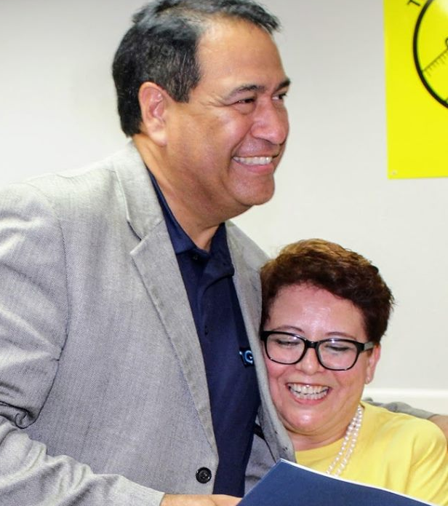
Proud!
We get the job done.
Corpus Christi AFT
We get the job done.
CCAFT is in collaboration with CCISD in advocacy for you!
Join our movement today!
CCISD Superintendent Dr. Roland Hernandez
and CCAFT President Dr. Nancy Vera

